Slide 1
Federalism
POSC 1101—Fall 2014
Lowi et al.
Chapter 3

Slide 2

What is federalism?
Unitary System
  Power held by a central authority at the national level
  Exp: Most governments in the world
Confederation System
  Power held by units at the lower levels (i.e. provinces or states)
  Exp: US under Articles of Confederation; Confederate States of America (CSA)
Federalism is a hybrid arrangement that mixes elements of a confederation (lower level has real power) and a unitary (national level monopolizes constitutional authority) government.
What about local governments (i.e. cities, counties)?

Slide 3
American-style federalism
Throughout US history, power has vacillated between the federal government and the states.
  Under the Articles, power was delegated mostly to the states
  by allowing state governments to do most of the fundamental governing, the Constitution saved the national gov’t from many policy decisions that might have proven too divisive for a large and very young country.
  By the 1930s (The New Deal), the federal government began assuming more power and authority.
  Today under an era of ‘New Federalism,’ power appears to be moving back towards the states.
American federalism consists of two types of federalism: Dual and Shared

Slide 4
Dual Federalism
This type of federalism leaves the states and the national government presiding over mutually exclusive “spheres of sovereignty”. [Layer Cake Analogy]
National/Federal: Foreign policy, national defense
States: Elections, Education
Much of the late 1700s and 1800s saw a fairly high degree of dual federalism.
  The federal government was relatively weak and highly focused on issues such as commerce regulation
Notes:
James Madison described this arrangement (and the intent of the Framers) in Federalist No. 45. He wrote, “The powers delegated by the proposed Constitution to the Federal Government are few and defined. Those which are to remain to the State Governments are numerous and indefinite.

Slide 5
Dual Federalism
Today, the national government has a hand in almost all policies that “concern” the lives of the citizenry.
Nationalization has shifted the “indefinite” authority Madison assigned to state governments to the national side.
Dual federalism no longer describes that nature of national and state relations.
We now have what is called Shared Federalism.

Slide 6

Shared Federalism
The second and more accurate conception of federalism called shared (or cooperative) federalism, recognizes that the national and state governments jointly supply services to the citizenry. [Marble Cake Analogy]
The complex nature and scope of modern problems often mandate a joint, cooperative strategy across all levels of government (federal and state)
    Drug trafficking and gangs
    Immigration
    Spread of epidemics
    Food contamination

Slide 7
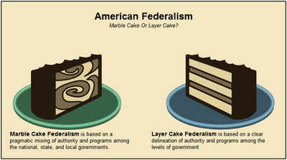
Marble vs. layer cake federalism

Slide 8
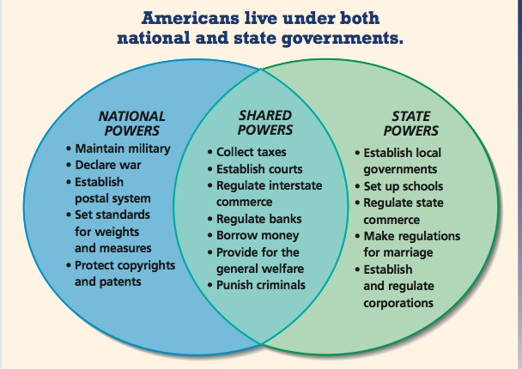

Slide 9
Why Federalism Matters: Hurricanes Katrina and Sandy
In the case of Hurricane Katrina (2005), federal, state, and local officials blamed one another for the government’s slow response.
When Hurricane Sandy (2012) hit the New Jersey shore, President Obama and state and local officials were very careful to work together to coordinate disaster response.
Notes:
Video Suggestion:
The blame game and the bickering between federal officials and state and local officials in the aftermath of Katrina ultimately cost FEMA Director Michael Brown his job. In this video from The Daily Show with Jon Stewart (www.thedailyshow.com/watch/wed-september-28-2005/headlines---mike-and-the-mad-dogs), notice how Brown is careful to blame state and local officials in Louisiana for the government’s slow response, and how members of Congress (some of whom represent communities on the Gulf Coast) blame Brown and FEMA. The public was largely confused by all of the bickering, in part because the federal relationship is a complicated one that is not well understood by most citizens. By the time Hurricane Sandy hit the New Jersey shore in 2012, President Obama and Chris Christie, governor of New Jersey; Andrew Cuomo, governor of New York; and Michael Bloomberg, mayor of New York City had clearly taken note. They worked together very closely in the midst of a heated presidential election despite coming from opposing partisan camps. Note how different the take on federal coordination was on The Daily Show’s coverage in the aftermath of Hurricane Sandy (http://www.thedailyshow.com/watch/wed-october-31-2012/a-daily-show-tribute-to-institutional-competence).

Slide 10
Muddiest Points
Everyone take five minutes and write down one or two concepts, points, ideas, theories, etc. that we have discussed so far in class that still confuses you or that you want more elaboration on.
We’ll spend a little time going through them today and perhaps Thursday

Slide 11
Thought & Discussion
Do you think that the founder’s system of checks and balances and separation of powers (including federalism) work to our advantage or disadvantage today? Why or why not?
What powers do you think are best left to the federal government? To the states? How about to both? Why?
What are some of the important roles that government (either state or federal plays)? What are some of the areas where change might be required?

Slide 12
State Responses to Collective Action Problems
The kinds of collective action problems that prompt states to ask Washington for help often fall into one of three categories:
  Coordination problems
  Free riding/Reneging and Shirking
  Cutthroat competition

Slide 13

Coordination Problems
Difficult to coordinate 50 different states.
Example of drivers’ license laws
  Standardization for interstate truckers
  Creation of bureau within DOT to centralize records of traffic violations
  Easier to create centralized record keeping than to require each state to update its records with those of every other state.

Slide 14

Reneging and Shirking
One realm in which classic free riding remains commonplace is protection of a region’s natural resources.
An example: During the 1950s and 1960s no state on the eastern seaboard wanted to lose its cod industry, but without a means to assure compliance, none controlled its harvest. The fishery collapsed. 2013 similar issues – Commerce Department receives recommendations from New England Fishery Management Council.
In the West and south, water is a serious issue. Who will force compliance?
  Exp: The current ‘Water Wars’ between Georgia, Alabama, and Florida
Clean Air – no borders – need for national solution – Clean Air Act
Notes:
Scores of fishermen gathered Wednesday in Portsmouth, New Hampshire, to hear the vote of the New England Fishery Management Council, which has since submitted its recommendations to the federal government.
"We're doomed, as they say," said fisherman Dennis Robillard, whose voice wavered as he acknowledged that his boat, the Julie Ann II, is now up for sale.
"I'm getting out. It just doesn't make any sense to me anymore."
The council also voted to cut 55% of cod catch rates in Georges Bank, an expansive area near Cape Cod, which was named by a 17th century British explorer after discovering an abundance of the ground fish.
If approved by the Commerce Department, fishermen catch rates will drop to about 3,550 metric tons of cod in the Gulf of Maine and Georges Bank.
A decade ago, they could net around 20,000. (2013)

Slide 15
Cutthroat Competition
At various times the dilemma of cutthroat competition has prompted state officials to lobby Washington to prevent bidding wars.
  Example of labor standards
  Environmental regulation-lax
  Tax breaks as incentives to business to locate in the state.
    Exp.: KIA plant on Georgia-Alabama Border

Slide 16
The Political Logic of Nationalization
Sometimes those promoting a policy find that it is in their interest to shift their focus from the states to the national government. Why?
  National government may be more receptive.
  Difficult to lobby/persuade 50 separate states.
  More efficient method – a single federal law can change policy in all 50 states at once.
  Are there some types of issues that should be left to the states though?
    Exp: Gay marriage or marijuana legalization perhaps?
Notes:
Example from the text: Mothers Against Drunk Driving (MADD) and federal highway monies.
Classic example: Civil rights; some preferences regionally concentrated.

Slide 17
The Supremacy Clause
Perhaps the most significant component of the Constitution regarding federalism is the Supremacy Clause
“This Constitution, and the Laws of the United States which shall be made in Pursuance thereof [that is, in keeping with the principles of the Constitution] …shall be the supreme law of the land.”
Essentially, federal laws and regulations supersede state laws and regulations—provides federal gov’t a great deal of power
Framed to avoid impasses over jurisdiction rather than to cede to the national government broad, preemptive authority over the states.
Notes:
The original intent was simply to have the national government prevale when both governmetns were acting in a constitutionall correct manner.
Created to avoid impasses rather than to cede the oteh national government borad, preemptive authority over the states.

Slide 18
Federalism and The Powers of Congress
Article I, Section 8 lists powers of Congress. (enumerated powers)
These powers are important to federalism because they create jurisdictional boundaries between the states and the national government.
Some powers are broadly stated and thus helped open up state policy to national intervention.
Commerce Clause: To regulate commerce with foreign nations, among the several states and with the Indian Tribes. Consistently interpreted in favor of national power.
Elastic Clause: In addition the elastic clause also eventually undermined the restrictive purpose of the enumerated powers.
Notes:
Example is the commerce clause.
Nation’s economy quite integrated.
McCulloch (affirmed implied powers)
Gibbons – New York Could not grant a monopoly to Fulton Steamboat company – established the supremacy of the national government in all matters affecting interstate commerce.

Slide 19
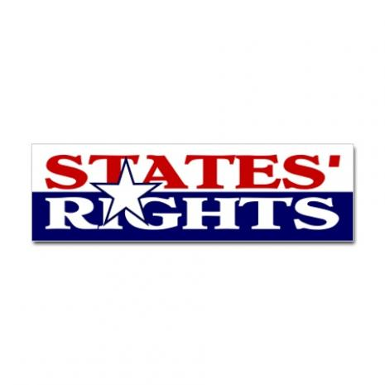
The Tenth Amendment
Given the fear of tyranny as articulated by the Anti-federalists it is not surprising that Madison had to promise the addition of a Bill of Rights as an incentive for ratification.
Many members of the first Congress wanted protections for the states as well as for individual citizens.
The Tenth Amendment offers the most explicit endorsement of federalism to be found in the Constitution.
Yet despite its plain language, the Tenth Amendment has failed to play a major role in fending off national authority.

Slide 20
The Role of the Supreme Court
McCulloch v. Maryland (1819)
  State of Maryland attempted to tax the Second Bank of the United States by placing a tax on all notes of banks not chartered in Maryland.
  The Supreme Court invoked the Necessary and Proper/Elastic Clause which allowed the Federal government to pass laws not expressly provided for in the Constitution, provided those laws are in useful furtherance of the express powers of Congress.
Gibbons v. Ogden (1824)
  In a dispute over state laws granting navigation rights to territorial waters of particular states (i.e. New York), the Supreme Court determined that federal rules/regulations regarding interstate commerce were supreme to state laws, which is granted by the Commerce Clause.

Slide 21
From dual to shared federalism
During the New Deal (1930s), Congress enacted legislation expanding the federal government’s role in regulating commercial activity.
Marked by supportive relations, sometimes partnerships, between the federal government and the state and local governments.
A rise in “grants-in-aid” : funds given by Congress to state and local governments (usually with few string attached)
Overtime, however, the Federal government began placing limitations and restrictions on that aid.
  Exp.: Categorical Grants (Grants for very specific purposes); Unfunded Mandates

Slide 22
Regulated federalism (1960s-1990s)
The federal government dictates national standards states must meet or rules states must follow.
A rise in unfunded mandates: national standards or programs imposed on state and local governments without accompanying funding.
Also a rise in partial preemption
  Certain federal laws allow the states to administer joint federal-state programs so long as they conform to federal guidelines.
  If an agency fails to follow the instructions of the federal agencies, the state might lose control of the program.
  Example: State air pollution policies

Slide 23
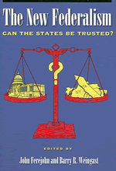
New federalism (1990s-present)
Efforts to craft national policies to return more discretion to the states
Rise in block grants
  Grants with only general requirements (as opposed to categorical grants)
Unfunded Mandates Reform Act
Loosening of federal restrictions on grants-in-aid, like the Welfare Reform Act
Efforts by the courts to interpret the interstate commerce clause more narrowly
  Exp: United States v. Lopez (struck down federal law banning guns on school grounds as overextension of commerce clause)

Slide 24
