Slide 1
The Logic and Principles of American Politics
Lowi, Chapter 1
8/19/2014

Slide 2
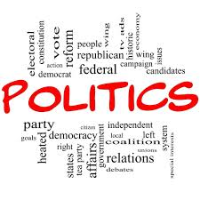
Agenda
Basic Concepts
The Five Principles of Politics
  Rationality and purpose
  Collective Action and problem-solving
  Institutions and structure
  Political Outcomes as product of rationality and institutions
  History and identity

Slide 3
Basic Concepts
Politics arises from the need to choose among alternatives when differences make it impossible for everyone to get what they want.
  Choices breed conflict due to conflicting interests, values, and ideas about how to allocate scarce resources.
  Politics is how people manage such conflict and agree on a collective action.
To carry out the act of politics, some sort of structure and rules must exist to allow for the management of this process.
Hence Government is necessary. What would the absence of government (i.e. anarchy) look like?
What institutions and rules does our government have to mitigate these problems?

Slide 4
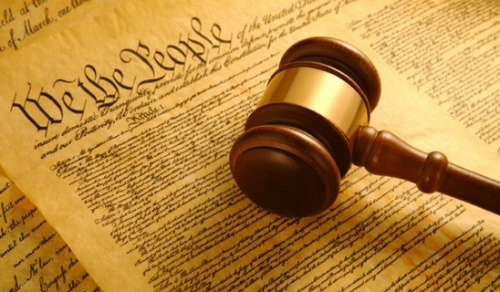
Different Forms of Government
Fundamentally about where authority and/or power is derived from and who possesses it
Democracy (authority derived from the people and usually delegated to others)
  Direct Democracy vs. Republic
Autocracy or Dictatorship (power held by one individual)
  Also includes monarchies (i.e. United Arab Emirates; Brunei)
  Authoritarianism vs. Totalitarianism
Oligarchies (power held by a small group of wealthy/influential individuals)
Theocracies (power is held by both representatives of the people and of some religious order)
  Example: Iran, Saudi Arabia

Slide 5
Rationality as a Framework
Rational Choice Approach
Rational ordering of preferences and goals
  All about probabilities of potential political outcomes and the costs associated with each choice
  Primary objective: to realize highest preference for the lowest cost
  Makes it possible to anticipate and even predict some political interactions and outcomes
  Example: What priorities and preferences might a member of Congress from Athens, Georgia have? Why?
  But most decisions are not unitary (by one person alone), but collective

Slide 6
Collective Action
Politics by nature is about collective action
  Resources such as time, energy, money, attention, etc. are all scarce (not enough to go around)
  Requires individuals and groups to compare and debate preferences, agree on a course of action, and about how to implement and enforce the collective choice.
  Becomes even more difficult as the number of members of a group increases.

Slide 7
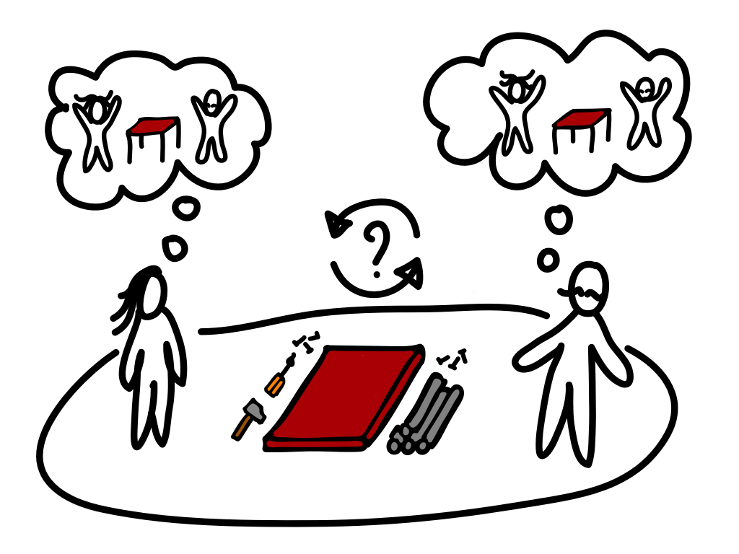
Collective Action Problems and Solutions
Coordination Problems
  Informal and Formal Bargaining
Prisoner’s Dilemma
Free Rider Problem
  Public vs. Private Goods
Tragedy of the Commons

Slide 8
Coordination Problems
Groups are made up of many members with divergent interests and needs
Each member must determine their preferences and what, if anything, they are willing to contribute to the collective decision
Members must then discuss, debate, bargain, and coordinate their efforts to arrive at some collective outcome and then implement it
  Informal (few rules and unstructured) vs. Formal (rules and structure) bargaining
How might you solve a coordination problem?

Slide 9
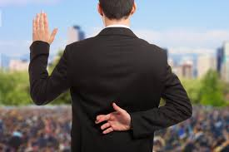
Delegation
The ease by which collective decisions are coordinated is influenced by the size of the groups
  Examples: String Quartet vs. Symphony Orchestra; House vs. Senate
In larger groups, some power and authority is often delegated to one or more individuals to make decisions on behalf of the collective
This creates a Principal-Agent Relationship
  Principal = the one being represented and the original source by which authority is often derived
  Agent = the one selected or elected to represent the collective
The potential for agency loss

Slide 10
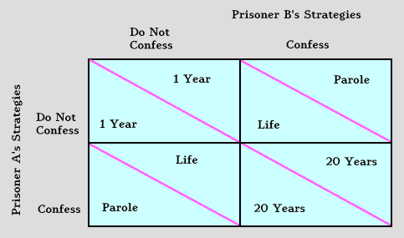
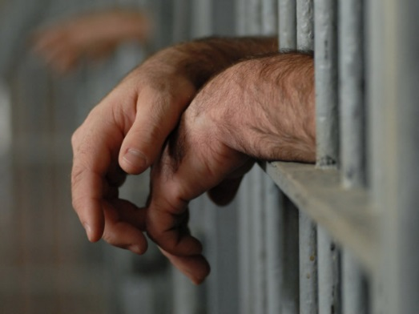
Prisoner’s Dilemma
Arises whenever individuals decide that even though they support some collective undertaking, they are personally better off pursuing an activity that rewards them individually while undermining the collective effort.
Examples: Global Response to ‘Climate Change’; The Stockpiling of Nuclear Weapons
How might you solve a prisoner’s dilemma? We’ll see later.

Slide 11
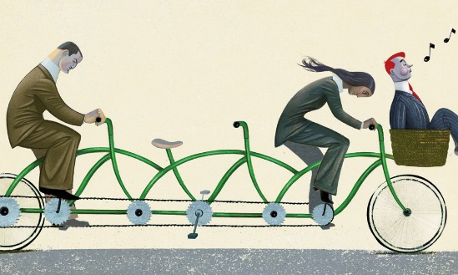
Free-Rider Problem
In a large group, the behavior of one member can be hard to monitor
  It becomes easier for some members to ‘cheat’ and forgo any contribution to the collective effort but still receive any benefits from it.
Arises when citizens recognize that their small contribution to the collective enterprise will not affect its success or failure (or be noticed for that matter).
  Example from Thursday?
Examples: Voting Turnout; Contributions to PBS or NPR
How might you solve this problem?
Positive incentives (sticker for voting); Selective Incentives (gifts); Inducements (fines or rules that force participation)

Slide 12
Tragedy of the Commons
Remember, resources are scarce; however, everyone wants to maximize profits. What happens if everyone takes as much as they can from a common resource?
Examples: Overgrazing in a Collective Pasture (Cliven Bundy vs. the Bureau of Land Management in Nevada); Crabbing off the coast of Maryland
Even when it might be in the interests of all involved to cooperate and share a resource, individual self-interest will often prevent cooperation.
  How then might we solve this type of problem?
Monitoring and Enforcement (make rules and punish those who violate) [i.e. as in the case of Bundy vs. the BLM]
  Requires the establishment of an institution and rules
Privatize (make it private and then users must pay)

Slide 13
The Costs of Collective Action
The solutions to these problems provides members with more benefits than if they were to try to act alone. However, they are not cheap.
Transaction Costs = The time, energy, and scarce resources to enact a collective plan.
  This effort increases as the number of participants rises.
  Example: high transaction costs for changing the US Constitution; conducting a national election for President
Conformity Costs = Difference between what any one party prefers and what the collective body requires.
  It is the extent to which a collective decision obligates participants to do something they prefer not to do.
    Example: Paying taxes; Violation of privacy for security (slippery slope)
  Inversely related to transaction costs

Slide 14
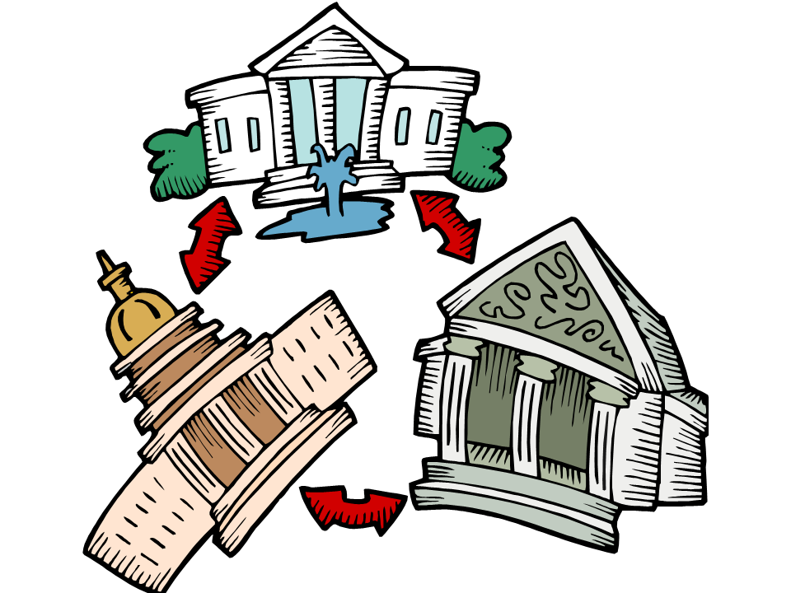
Institutions as Solutions
Institutions are created to solve collective action problems
  They provide an environment where interactions are repeated
  Repeated interactions encourages tit-for-tat strategies, trust-building, and the use of things such as reputation
  They can also induce cooperation by punishing defection/reneging and rewarding cooperation
    Example: The legal contract as an institution

Slide 15
Characteristics of Institutions
Jurisdiction
  The domain over which an intuition or member of an institution has authority
  Example: President as Commander and Chief
Agenda Control and Veto Powers
  Institutions decide what topics are to appear on the agenda and can often veto (say no) a proposal from another institution
  Example: President’s right to veto; Congress’ right to override veto
Voting Rules
  Get to determine who decisions are made (i.e. how votes are conducted)
  Majority rule; Supermajorities; Unanimous Consent; Plurality

Slide 16
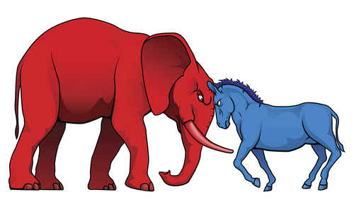
Political Outcomes
As we have seen, most political outcomes (collective decisions) are the product of negotiation and bargaining (coordination) as well as the rules and structure provided by key institutions such as a Constitution or a legislature.
Any one political outcome then is the product of inputs from a variety of sources
  Individual interests of a Congressmen (political ambitions; re-election)
  Collective needs of his/her constituency
  Rules and processes of key institutions (i.e. did Congressmen have to agree to support another policy/bill in order to gain favor for their policy/bill?)
A key point though is that the complexity of achieving such outcomes means that more often than not, change is difficult and the status quo usually prevails.

Slide 17
What’s Next
The Role of History
  How did we get to where we are?
  How did we develop the institutions and rules that we have today?
  What experiences did the nation endure to arrive to where we are today?
We’ll discuss the develop of the current Constitution, of Congress, the Presidency, and the Judiciary, the changing role of interest groups, the media, political parties, public opinion, etc. in politics.

Slide 18
Homework
Read Chapter 2 (pgs. 22-33) for Thursday
Weekly Analysis Paper #1
Hard Copy (printed and stapled) due next Tuesday (8/26) at the start of class
Instructions: Read the article passed around and answer the questions on the following page.
If you have any questions, email me at mclary105@gmail.com or see me after class/during office hours on Thursday!

