Slide 1
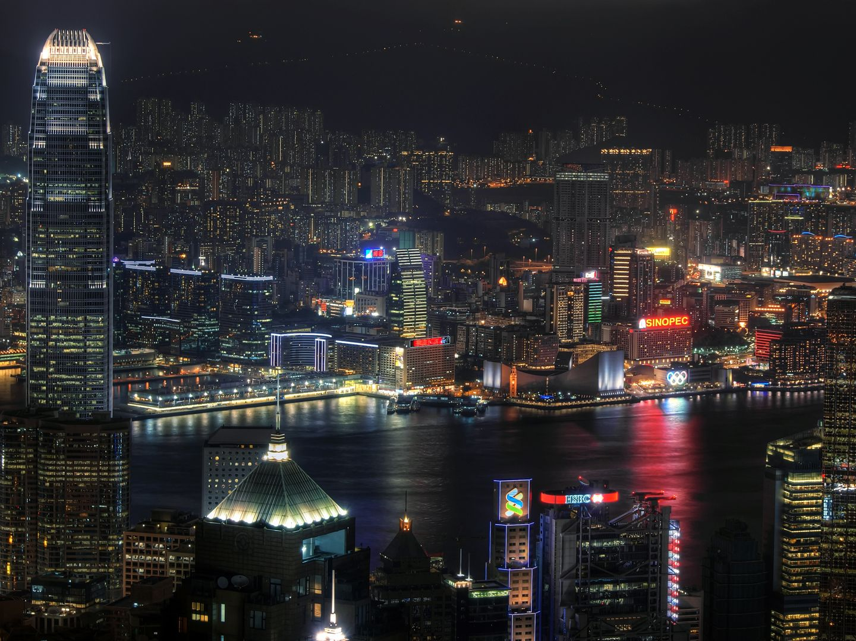
People’s Republic of China
By Travis McNeal, Hayden Barrett, Kaitlyn Walker and Jacob Black

Slide 2
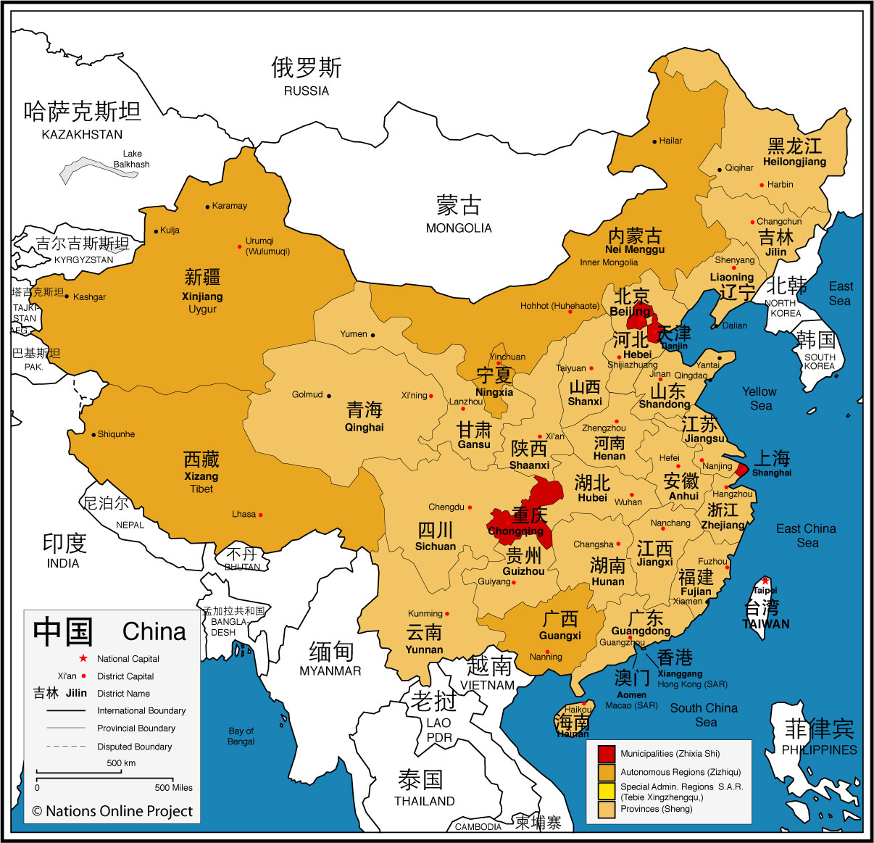


Slide 3
Government Overview
Which persons in China are granted suffrage?
Men, 18 and over
Communist Party members, 18 and over
All persons, 18 and over
No one

Slide 4
Government Overview
All persons, 18 and over, are granted suffrage
Government type: Communist party-led state
Administrative divisions: 22 provinces, 5 autonomous regions, 4 municipalities
President: Hu Jintao, serves as Chief of State
  Elected by the legislature
Premier: Wen Jiabao, serves as Head of Government
  Nominated by president, approved by legislature

Slide 5
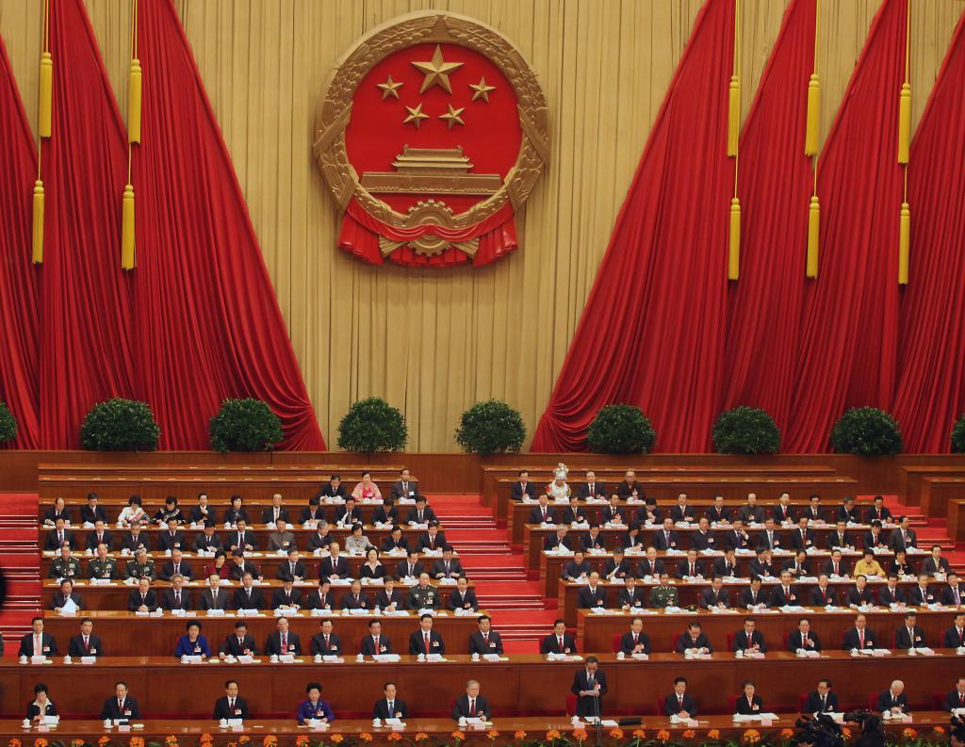
Branches of Government
Legislature: National People’s Congress (NPC)
  Unicameral legislative body
  Consists of 2,987 elected members who serve 5 year terms
  Supposed to be most powerful government organ according to 1982 constitutional reforms
Executive: State Council
  Members include the premier, 4 vice premiers, 5 state counselors, the central bank governor, the secretary general, and 25 ministers
  Members are selected by the NPC
Judicial: 3 Main Court Systems:
  Supreme People’s Court
  Local People’s Courts
  Special People’s Courts

Slide 6
Influential Organizations
Which of the following is the most powerful governing body in China?
The National People’s Congress
The State Council
The Politburo
The Supreme People’s Court

Slide 7
Influential Organizations
Political Bureau (Politburo)
  Core of governmental power in China
  Consists of 25 members who are elected by the Communist Party’s Central Committee
Party Elders
The Central Discipline Inspection Commission
  Party mechanism to investigate and prosecute party members for corruption/malfeasance; used to sway public opinion towards the CCP
Military Affairs Commission (MAC) & Armed Forces
  MAC consists of 11 members who have final authority on senior military appointments, troop deployments, and arms spending
  MAC Chairman is always top party official & selected by NPC

Slide 8
Where the Real Power Lies
The real power of government lies within various standing committees whose members usually overlap
The State Council, Politburo, and National People’s Congress all have standing committees
These committees ensure power consolidation and effectuate party policy across the various agencies and bodies of government

Slide 9
Economy
GDP: $7.301 trillion (Nominal), $11.31trillion (PPP) (2nd in world for both)
GDP growth: 9.5%
GDP per capita: $5,184 (Nominal), $8,394 (PPP)
GDP by sector:
  Industry (46.8%), services (43.6%), agriculture (9.6%)
Inflation (CPI): 4.9%
Labor force: 780 million
Labor force by occupation:
  Agriculture (39.5%), Industry (27.2%), Services (33.2%)
Unemployment: 4.2%
Average gross salary: $4,260 annually

Slide 10
Industry
What is one of China’s most important industries?
Sulfur mining
Tire manufacturing
Coal mining
Automobile production

Slide 11
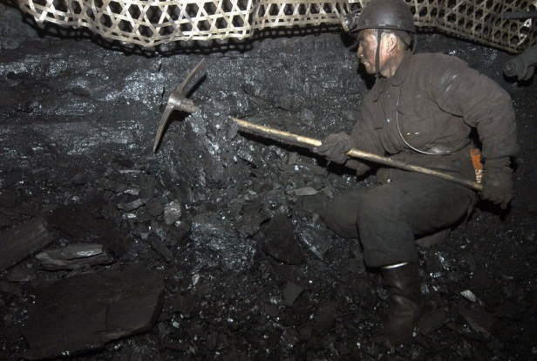
Industry
The main industries in China:
  Mining and ore processing (iron, steel, aluminum, and other metals, coal), machine building, armaments, textiles and apparel, petroleum, cement and chemicals
Numerous minor industries as well

Slide 12
Trade
China’s export destinations:
  U.S(20%), Hong Kong(12%), Japan(8%), South Korea(5%), Germany(4%)
China exported about $1.6 trillion in 2010
Major Importers to China:
  Japan (12%), Hong Kong (10)%, South Korea (9%), US (8%), Taiwan (7%), Germany (6%)
China imported about $1.3 trillion 2010

Slide 13
Wages and Wealth
China may be on the world stage in terms of power and fiscal strength, but its people are some of the lowest paid in the world.
On an average the common person in China makes about $4,200 a year which gives it a world rank of 107th out of the 198 other countries who provide information on average income.

Slide 14
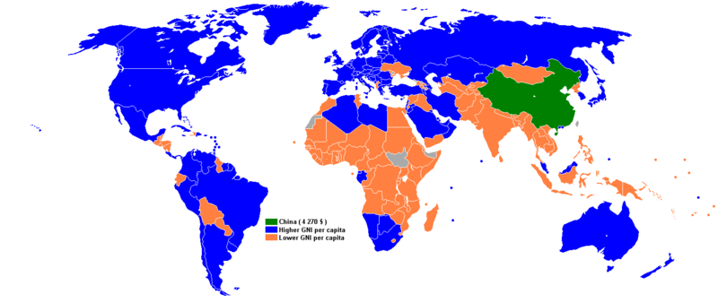

Slide 15
Quality of Life
Approximately what percentage of people in China live in urban areas?
32%
94%
63%
48%

Slide 16
Quality of Life
47.8% of China’s population lives in urban areas
Approximate population: 1.4 billion
Life Expectancy: 73.5 years
Percent of population living below $1.25 PPP per day: 15.9%
3.1%, 29 million, living below absolute poverty line
6.0%, 56.2 million, living below low-income line

Slide 17
Education
9 years of formal education required by law
Preschool/kindergarten, 3-6 years
Primary school, 6-12 years
Junior Middle School, 12-15 years
Zhong Kao Exam
Senior Middle School, 15-18 years
Gao Kao Exam
National Key or Provincial Key Universities, or Normal University

Slide 18
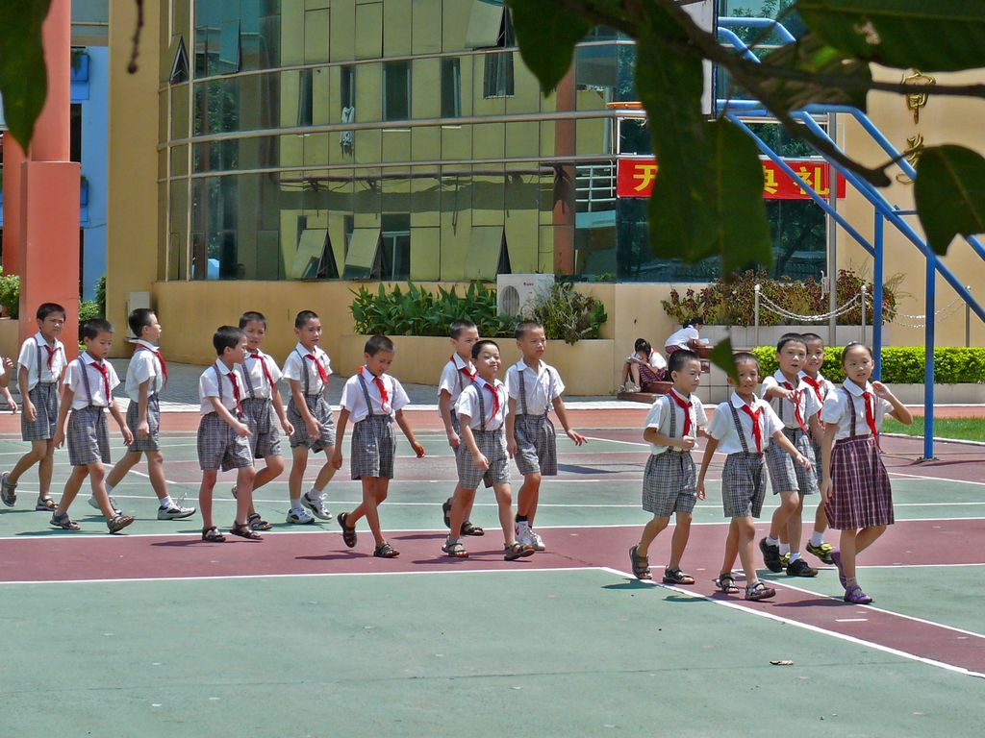
Education
Average of 7.5 years of schooling for adults over 25
Adult literacy rate: 94.0%
Female : Male minimum secondary education ratio: 0.778

Slide 19
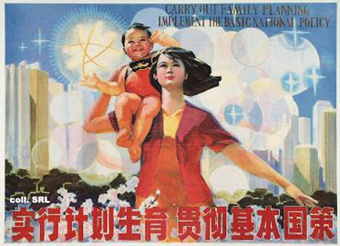
Gender Equality
The Chinese Constitution (1993) mandates equal rights for all citizens regardless of gender
Social barriers exist to implementing equality
  Traditional cultural attitudes-Chinese tradition places the woman as head of the household and should only be devoted to child bearing and rearing
  Legal Rights are implemented according to current Chinese policy-there is no universal belief in natural rights in China
  Population growth places emphasis on family planning-the official stance of the Chinese government is that family planning is voluntary but the One Child policy causes a forced abortion in China
  every 2.4 seconds

Slide 20
Gender Equality-Workforce
Women are also given additional legal rights under the Law for Protection of Women’s Rights and Interest which include
  Right to equal pay
  Medical care and protection during pregnancy, childbirth, and baby nursing periods
  Cannot be dismissed from work or denied employment on the grounds of marriage, pregnancy, or nursing
However, Periodic Employment is encouraged-idea that women should take off several years of work after giving birth to raise children
Women’s salaries are on average 80-90% of men’s salaries
The most common industries for female employment are textiles and food service
Job discrimination is legal if the state deems a job “unsuitable for women”

Slide 21
Economic Equality
What percent of China’s poor comes from rural areas?
99%
90%
51%
37%

Slide 22
Economic Equality
99% of China’s poor come from rural areas
About half live in Western regions
Highly structured socio-economic classes
Bourgeoisie, petty bourgeoisie, middle class, proletariat, semi-proletariat and peasants

Slide 23
Ethnic Equality
How many officially recognized ethnic groups exist in China?
1
56
100
7

Slide 24
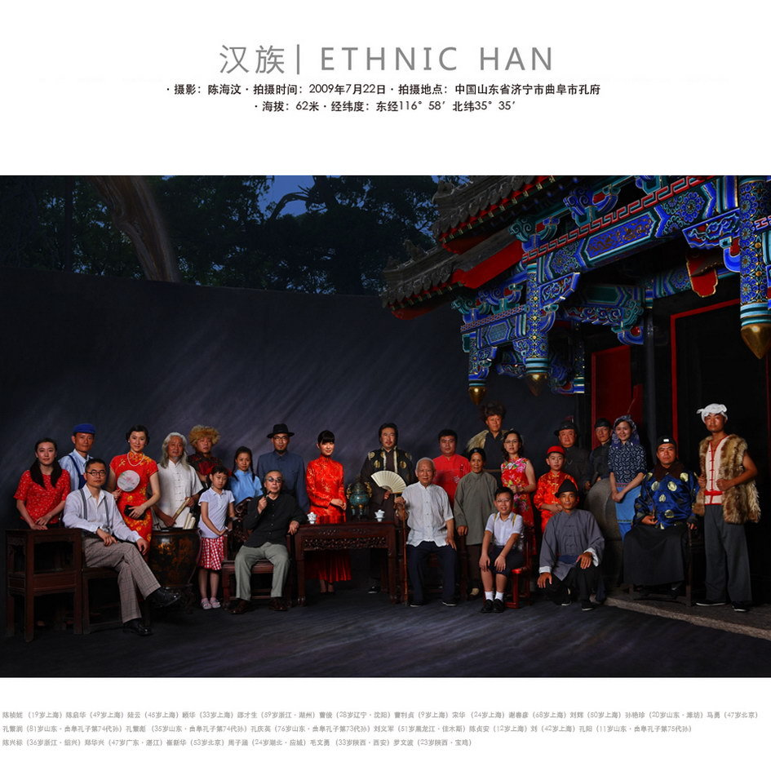
Ethnic Equality
56 officially recognized ethnic groups
91.9% Han
Major minority groups: Zhuang, Uigur, Hui, Yi, Tibetan, Miao, Manchu, Mongol, Buyi, Korean

Slide 25
Immigration
There are 3,852,000 immigrants in China, 0.2% of population
Mostly from Vietnam and other regions of Southeast Asia
Population of immigrants is not significant, but immigrants often fill lower paying, labor intensive jobs and are considered desirable workers who work for cheap wages

Slide 26
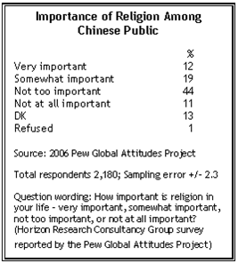
How Important is Religion?

Slide 27
Religion
How many officially sanctioned religions exist in China?
0
1
5
23

Slide 28
Religion
There are 5 main religions practiced in China
  Buddhism varying estimated between 8-20% of the population
  Taoism
  Christianity 3-4% of the population (Protestantism and Catholicism)
  Islam 1-2% of the population
31.4% of Chinese adults identify themselves as religious according to a state-run survey in 2009
Confucianism (Chinese humanism) is also practiced, however is considered more of a moral ideology than a religion

Slide 29
Religion and Government
Article 36 of the Chinese Constitution says Chinese citizens “enjoy freedom of religious belief”
The CCP identifies itself as Atheist
  the official stance of the party is that party affiliation and religious affiliation are mutually exclusive
  Members are discouraged from participation
The Chinese government requires religious groups to apply with the state in order to practice
Only recognizes 5 religion as legitimate-Buddhism, Taoism, Islam, Catholicism, Protestantism
The State limits the number of people who can register to join each church
  Estimated 50-70 million Chinese are apart of the underground Christian movement

Slide 30
Human Rights
Estimated 500,000 detained with charge or trial
China is #1 user of the death penalty
Tibet and Taiwan
Reeducation through Labor
Censorship is highly prevalent
  Internet sites often shut down or blocked
  Individuals’ actions often tracked

