Slide 1
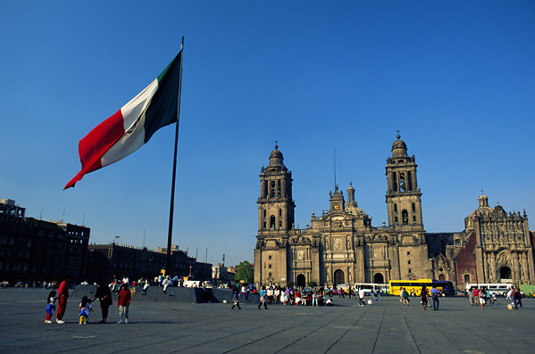
Mexico
Lendon Alexander, Rachael Zipperer, Melissa Cerqueira, Jake Taylor and Keith Llado

Slide 2
Social
What are the major social and ethnic groups within your nation?
  White
  Indigenous (Amerindian/predominantly Amerindian)
    Descendants of ancient Mayan and Aztec cultures
  Mestizo (Amerindian-Spanish)
    “Mixed-Blood People” (Europeans and Indigenous People)

Slide 3
Social
How large are they?
  Mestizo accounts for 60%
  Indigenous populations account for 30%
  White accounts for 9%

Slide 4
Social
How do people (either inside or outside the nation) tell these groups apart?
  Region
  Economic class
  Social class
  Also, language, as some indigenous citizens still speak in their indigenous languages

Slide 5
Social
How is each of the major groups/divisions within society treated? (i.e. are they accepted? Is there conflict/disagreement between groups in society?)
  Mestizos control much of the social, political, and economic power
  Indigenous people are more likely to be impoverished or working class
  Economic disparity between classes

Slide 6
Social
How does the class system within your nation function? (i.e. is there a large upper class, large lower class?)
  Mestizos occupy the elite class (upper) and middle-class
  Indigenous people occupy the labor/working class or the poor population

Slide 7
Social
How easy is social mobility within your country pre-2000? (i.e. how easy is it for someone to move from one social/economic class to another?)
  Fairly easy
  Due to inclusiveness and corporatism of PRI

Slide 8
Immigrants in Mexico
More than 960,000 immigrants living in mexico in 2010
  76.8% from the United States
  Many others from Latin American and European Nations
Mexico has offered asylum to people of many nations
  Americans during McCarthyism
  Spaniards during the Spanish Civil War
  Guatemalans during counter-insurgency conflict
Detained more than 182,000 illegal immigrants in 2006

Slide 9
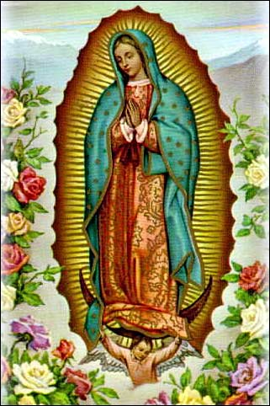
Culture and Religion
Strong Indigenous and European Heritage
Close family bonds
Mainly Catholic
  76.5% Catholic, 6.3% Protestant

Slide 10
Social: Equality of Women
Most gender inequality stems from cultural practices.
Mexico has a score of 0.576 on the Gender Inequality Index and out of 169 countries is ranked 68; however, there are some areas in which Mexico faces significantly more gender inequality than others.
  Labor: The area with the highest inequality. Only 46.3% of women are currently in the workforce and there are still significant differences in the wages of men and women.
  Education: Only a +5 point difference between men and women.
  Political participation: High level of participation of women in politics with 22.1% of the seats in Congress filled by women.
  Reproductive Health: Prevalence of contraception is at a rate of 70.9%.

Slide 11
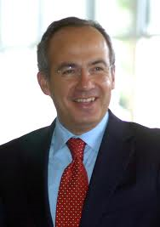
Political: Political System
Type of System: Federal Republic
  Independent executive, legislative, and judiciary branch
    Executive: president serves as head of state and head of government; no vice president
    Legislative: bicameral; made up of Senate and Chamber of Deputies
    Judiciary: divided into federal and state systems; European civil law system
Felipe Calderón, the current president of Mexico.

Slide 12
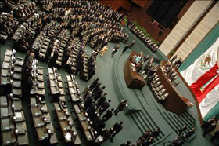
Political: Elections
Electoral System: Parallel
Universal Adult Suffrage
The President is elected through plurality vote.
The 128 seats of the Senate are filled using “a mixture of direct election and proportional representation” ("World Factbook" January 10, 2012).
Of the 500 seats in the Chamber of Deputies, 300 seats are filled using direct election to represent single member districts and 200 seats are filled using a form of proportional representation based on five electoral regions.

Slide 13
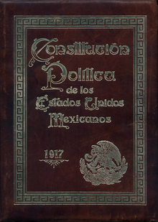
Political: Freedom in the Political System
The constitution guarantees freedom of religion, speech, and press. It also has provisions allowing for the right to bear arms, right to assemble, right of petition, right to trial, protection against unlawful search and seizure, protection against unlawful arrest and detention, no double jeopardy, etc.
  * The Constitution also specifically states that Mexican citizens have a right to a good job and housing.

Slide 14



Political Parties
3 major:
  National Action Party
  Institutional Revolutionary Party
  Party of the Democratic Revolution
Main parties, centrist lean left or right

Slide 15
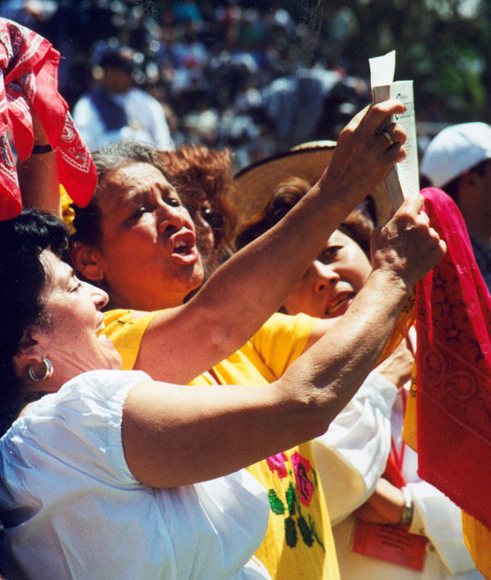
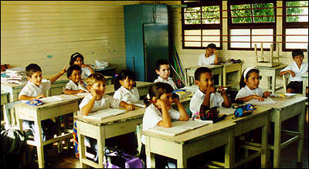
Human Rights & Education
Human Rights problems:
  Voter suppression
  Police brutality
  Women
  Drugs
Education:
  System much like US
  96% Literacy

Slide 16
Mexico’s Economy
2010 GDP – 1.567 Trillion – 12th in the world
2010 GDP Per Capita – $13,900 – 85th
% below the poverty line – 18.2% (Food), 47% (assets)
90% of the Mexican economy is based on free trade agreements

Slide 17
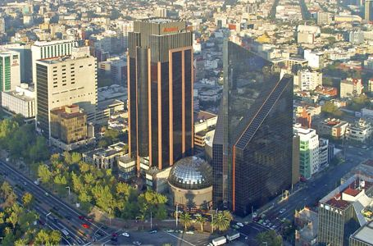
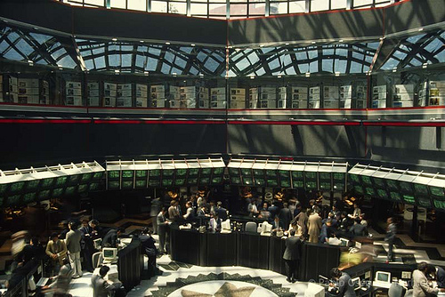
Mexico’s Economy
Important Industries/resources: oil, natural gas, textiles, manufacturing, tourism, agriculture, cheap labor
Unemployment – 5.4% (underemployment may be as high as 25%)

Slide 18
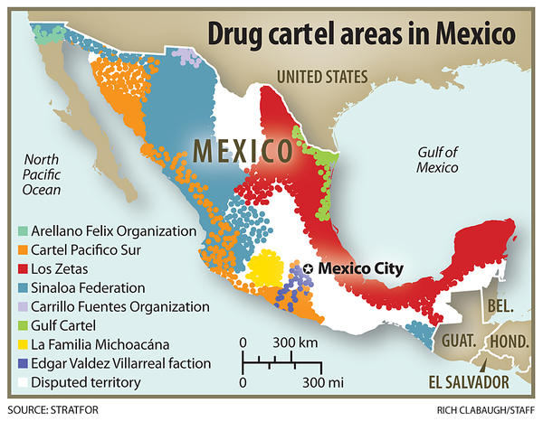
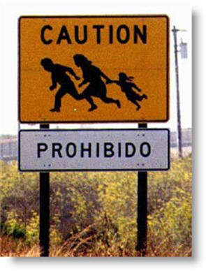
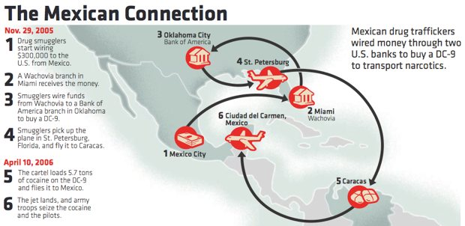
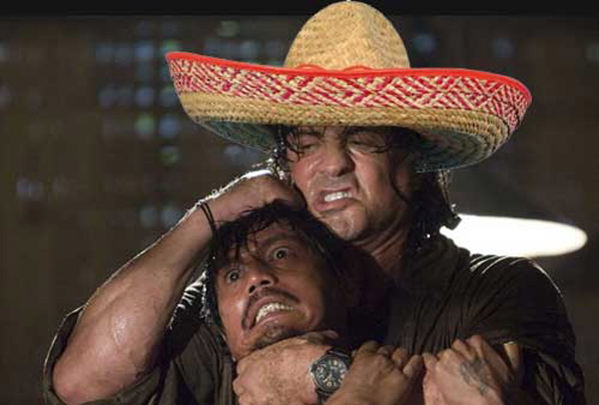
Mexico’s Economy

Slide 19
