Slide 1
Threat Down: “The Rise of China—Love the Panda or Fear the Dragon?”
INTL 4430
3/23/2012

Slide 2
Pre-Assessment
What should US policy be towards China: Containment, Engagement, Selective Engagement, Offshore Balancing, or some other grand strategic approach?
Remember—you’re making policy that should be designed to address the needs for today AND tomorrow.

Slide 3
Pre-Assessment
Select a President
Select a note taker
Select a Secretary of State (i.e. your diplomatic negotiator)
This will be a fast-moving, real-time threat assessment (similar to the course simulation in a couple of weeks)
How are you going to ensure that decisions are being made in a timely manner?

Slide 4
The Threat
Intelligence reports indicate that the Chinese have begun a massive mobilization of forces in the Fujian province just opposite of Taiwan. This mobilization could only be an organized war game that the Chinese are known to hold on a fairly regular basis or the first steps to indicate an invasion of Taiwan.
The mobilization involves over 100,000 armed troops, about 20% of China’s naval capacity in the Pacific basin, and the readiness of most of the missile installments along the Fujian coastline.

Slide 5
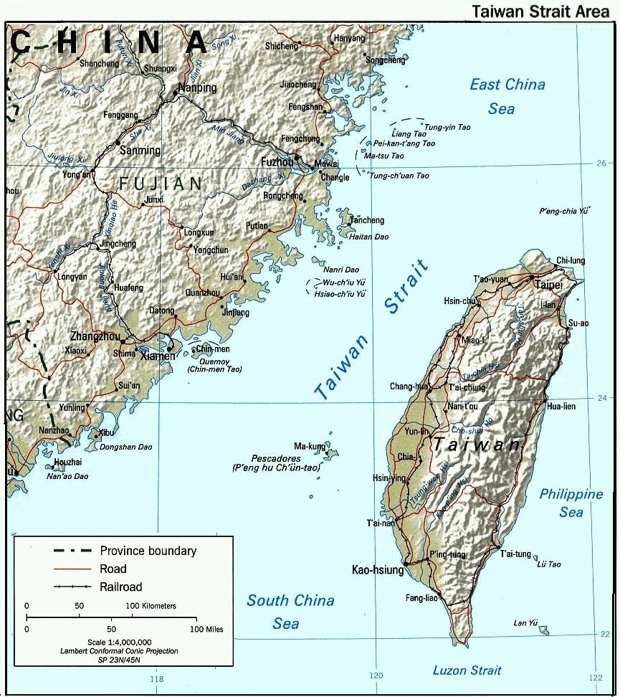

Slide 6
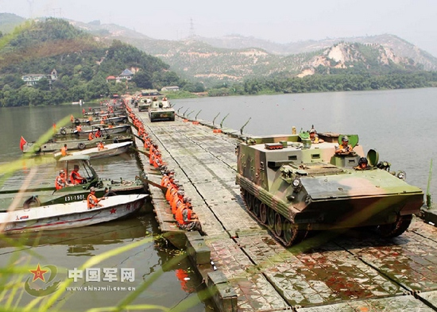
Footage of Chinese Mobilization in Fujian

Slide 7
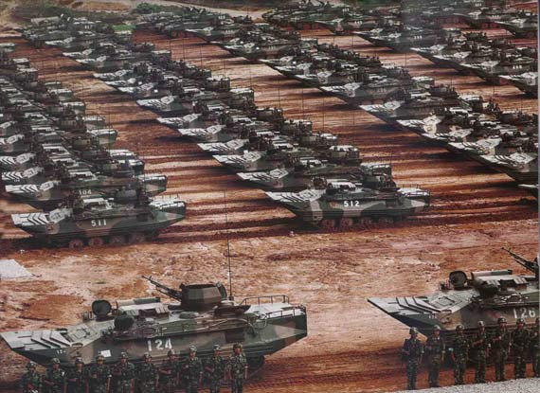

Slide 8
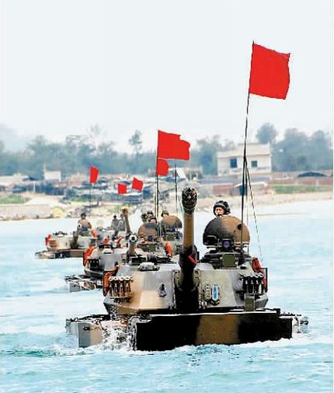

Slide 9
Chinese Amphibious Capabilities
A Taiwanese report in 2010 on “Military and Security Developments Involving the People’s Republic of China” asserted that the People’s Liberation Army (PLA) “regular amphibious abilities have increased, with transport capacity reaching a full division”
However, the DOD disagreed with this assessment at the time and suggested that its actions are primarily for deterrence purposes and not for the preparation of a short-term war.

Slide 10
Taiwan Relations Act of 1979
By law Washington is directed to view with "grave concern" any military threats to the increasingly democratic government on Taiwan that has evolved there since the Nationalist Chinese of Chang Kai-shek fled the mainland after losing to Mao Zedong’s communists in 1949.
However, no formal ‘defense’ treaty has existed since the US formally recognized the PRC in 1979.

Slide 11
Your Information
What you know: About a week ago, the Taiwanese Liberation Party began publically calling for the current government to push more stringently against the mainland ‘control’ over the island and to began the process of Taiwanese independence.
Chinese premier Hu Jintao announced nearly a week ago that the Chinese government would not tolerate any discussion of Taiwanese independence by the Taiwanese government.
What do you do?

Slide 12
Intell Report
IMINT (Imagery Intell) indicates that Chinese forces (approximately 10 Chinese planes and warships) are preparing for a live-action firing of air-to-air and –sea and sea-to-sea and -air missiles (M-9 intermediate-range missiles) in an apparently pre-designated area in the Taiwan Straits.
Potential ‘target’ locations for the missiles (based on capabilities) are projected to be either within the straits themselves or as far as the opposite shore of the island of Taiwan.
Analysis is unclear as to the intent of these launches at this time.

Slide 13
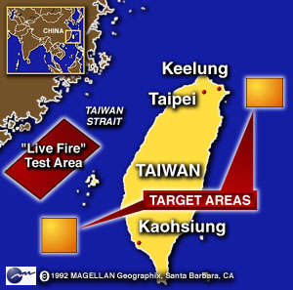

Slide 14
Location of U.S. Pacific Carrier Groups
The U.S. Pacific Fleet consists of the third (the USS Ronald Reagan) and seventh fleets (the USS George Washington) and carrier strike group 11 (the USS Nimitz)
The USS Nimitz is currently located in or near the Persian Gulf/Arabian Sea area, while the USS George Washington is located just off the South coast of Japan, while the USS Ronald Reagan is in port in Pont Loma (near San Diego, CA).

Slide 15
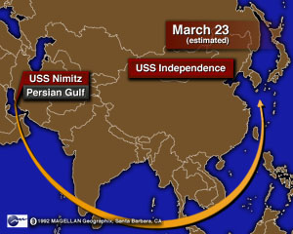
Dispatch of USS Nimitz to South China Sea

